Slide 1
Cybersecurity: Overview
Raj Bhatnagar
University of Cincinnati

Slide 2
Digital Data is Valuable: It is Everywhere
All businesses are becoming very digital
Lot of IP in manufacturing processes
Operational and Supply Chain Data
Control Systems on production floors
Where there is value, there are some people willing to steal it
All industries have faced cyberattacks
Financial Services, Banking, Credit Cards
Health Services, Patient Records

Slide 3
Cyber-Threats to Business Enterprise
Manufacturing is the 2nd most attacked industry behind healthcare (2015)¹
Exposure has increased: Networking of Industrial Control Systems:
Smart devices on floor
Distributed manufacturing facilities
Integrated enterprise-wide IT+OT Systems
Widely distributed supply-chain operations
Extensive internet connectivity

Slide 4
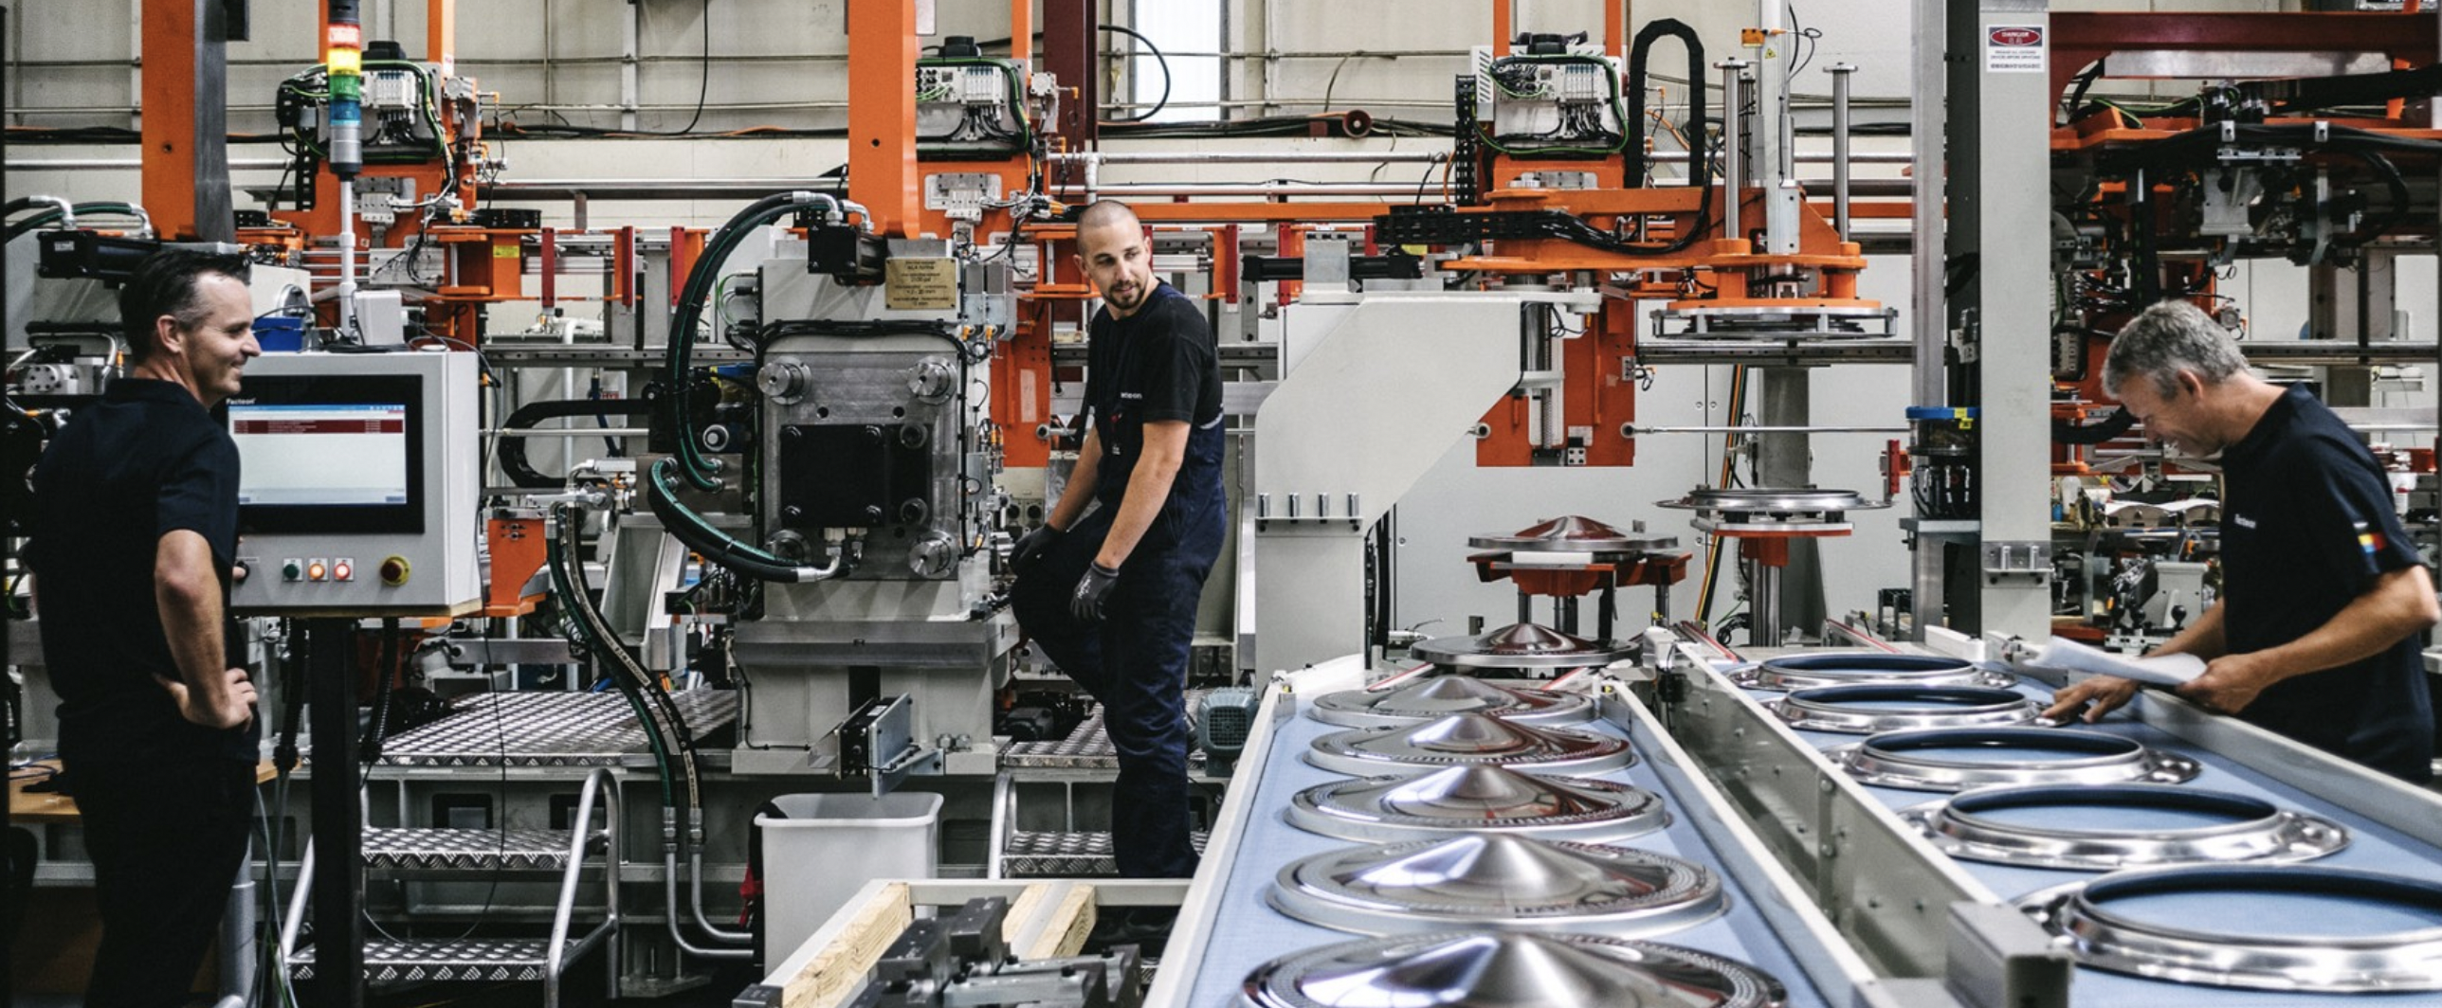
Integrated IT + OT
Information Technology + Operational Technology

Slide 5
Most Attacked Industries (2018)¹
Healthcare
5 major attacks in 2015; ~100 million records stolen
They bring high price on black market
Typically contain: SSN, Credit Card data, employment data, medical history
Used to launch spear phishing attacks, steal medical identities, commit fraud
Manufacturing
Automotive, Pharma, electronics and textile industries
Stealing IP is typically the main intent
Attackers also want to learn vulnerabilities in a “connected” car or electronic device

Slide 6
Most Attacked Industries (2018)¹
Financial Services
Major breaches in the past
Lot of work done to make infrastructure secure
Mobile devices have increased the vulnerability
Malicious attachments made ~40% of attacks
Government (Personnel data)
OPM breach
Transportation
Airlines, shipping, trains
Mainly driven by political or financial gain

Slide 7
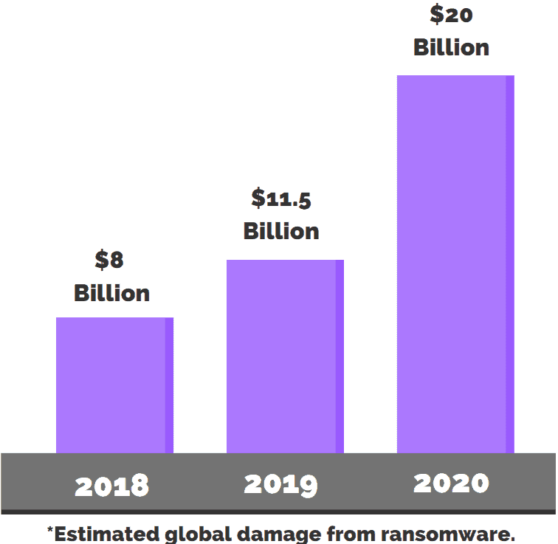
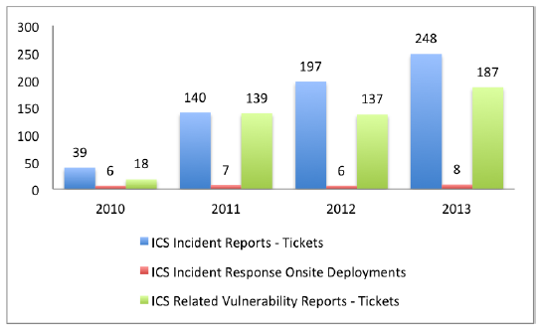
Incidents Reported to ICS-CERT
ICS-CERT is a DHS organization, focuses on reducing risk for critical infrastruture (ICS Cyber Emergency Response Team)
System owners can report security incidents within their ICS and obtain advice about mitigating it
ICS-CERT also publishes advisories about Vulnerabilities
Image source: NIST Special Publication 800 82 Rev2

Slide 8
Who are the Attackers (2018)¹
Insiders (60%)
Have physical or remote access to assets
Malicious Insiders (44%)
Steal content intentionally
Inadvertent Actors (16%)
Mistakenly let Intruders into the system
Employee education is very important to stop this
Outsiders (40%)
Malicious attackers who are after specific content
Hackers looking for vulnerabilities

Slide 9
Causes of Security Incidents (2018)¹
Unauthorized Access (45%)
Gained primarily via Phishing Attacks
Malicious Code (29%)
Downloads from infected sites
Sustained Probe/Scan (16%)
Intentional espionage
Suspicious Activity (6%)
Credentials Abuse (3%)

Slide 10
Main Types of Cyber Attacks
Malware: Various forms of harmful software
Phishing: Prompting user to click on a dangerous link
SQL Injection Attack: Forces SQL server to give database info
Cross-Site Scripting (XSS): Steal data a web user enters
Denial of Service: Flood a website with too much traffic
Session Hijacking: Steal session credentials to impersonate
Man-in-the Middle: Attacker inserts in the middle to steal entire conversation; and/or modify conversation too!
Credential Reuse: Credentials stolen from one website are used to break into other websites

Slide 11
Main Types of Cyber Attacks: Malware (1)
Malware: Mal(icious) (Soft)ware
Installed without user’s consent
Able to run without being detected, shut down, or deleted
1-in-14 downloads from internet contains Malware (A Microsoft Report 2014)
Intruder program that executes itself in your computer
Disrupting computing or communications
Steal sensitive data, access private networks
Identity theft, cyberwarfare, espionage
Service disruption by targeting specific companies

Slide 12
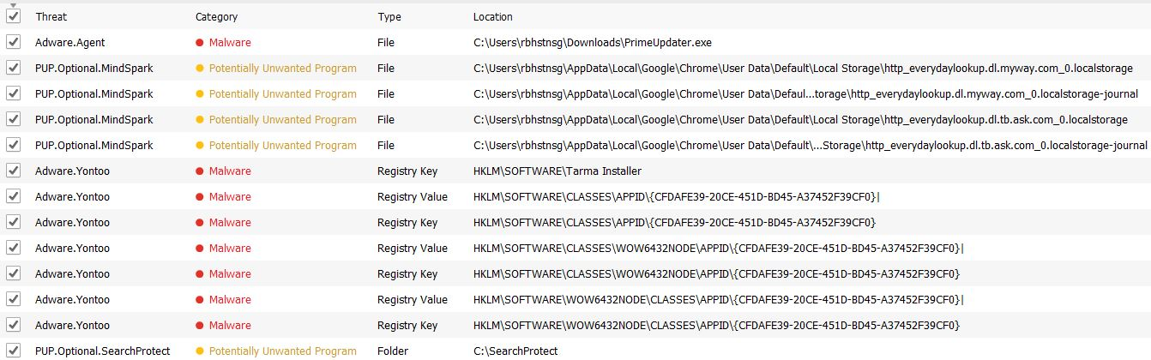
Malware Scan: this computer: Three months after cleaning

Slide 13
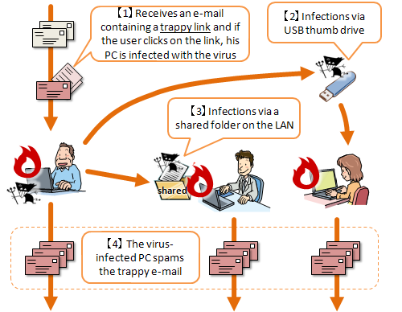
Types of Malware: Virus
Spreads via downloading or running an infected program
Typically travels attached with program files and documents
Image borrowed from: https://www.ipa.go.jp/security/english/virus/press/201009/E_PR201009.html

Slide 14
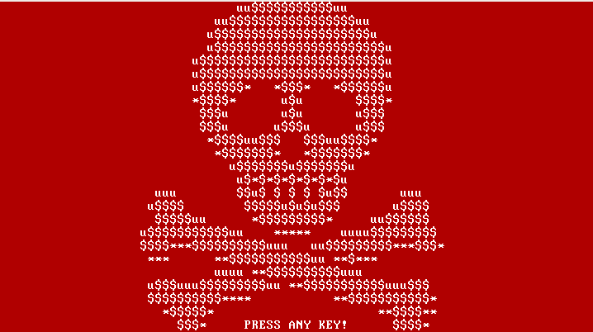
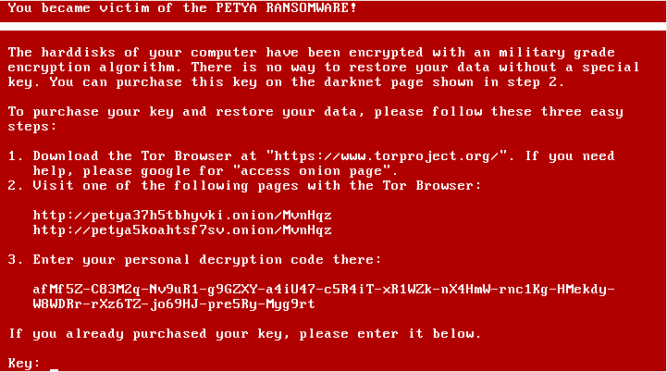
Malware: Virus
Recent Ransomware attacks:power grids and petroleum companies
An Older Ransomware attack (June 27th, 2017)
Was an attack to damage and destroy computers
Was not actually a Ransomware attack
Typical Ransomware
Encrypts all files on your disk
Demands ransom, and if paid, decrypts your file
Petya Ransomware attack (2016)
Spreads by malicious emails, e.g. an application for a job with CV attached
The CV is actually an executable, a self extracting archive
After deploying the application the system crashes, restarts and displays:

Slide 15
Malware: Virus
The Petya Attack (2016), Contd.
It overwrites the beginning sectors of the disk but encrypts and saves the original contents.
It demands ransom by taking users to their website.
A key is given to user after the payment
Using the key, the virus decrypts the encrypted files and restores the beginning sectors
The June 27^{th,} 2017 attack
Even though it demanded ransom (only ~$10,000 was paid) it did not have the capability to decrypt the files it encrypted
So, it appears it was intended only to cause damage and destruction

Slide 16
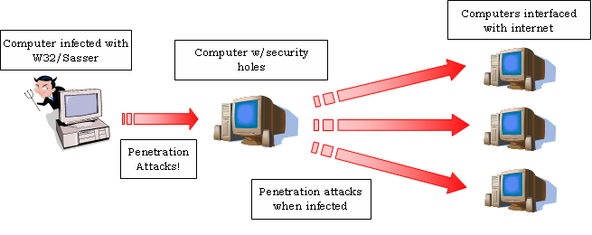
Types of Malware: Worm
Spreads itself by replicating across computers or networks
Image borrowed from: http://pamdemo.wikispaces.com/Sasser+Worm

Slide 17
An Example Worm: SirCam (~2001)
Propagates via email from infected computers
It affected Windows 95, Windows 98, and Windows ME
Starts with one of a few standard lines:
I send you this file in order to have your advice
I hope you like the file that I sent to you
I hope you can help me with this file that I send, etc.
Mechanism for spreading:
Choose document files (.doc or .xls) at random
Infect with the same code
Email it out to addresses in the host’s address book
Opening the infected attachment resulted in the target computer getting infected
Private files are shared with people and slows the system down

Slide 18
An Example Worm: StuxNet (~2010)
The worm is a “delivery vehicle” that carries a “payload” code that causes the damage
It infects a computer and hides itself
It exploits zero-day vulnerabilities
It checks if computer is connected to SIEMENS equipment (PLC)
If NO, it does nothing
If YES, It delivers the payload code to the PLC and executes it
It also reports incorrect information about the status of the target machines to the monitoring subsystem
Resulted in damage to ~1000 centrifuges at Natanz nuclear plant in Iran
Video on Stuxnet

Slide 19
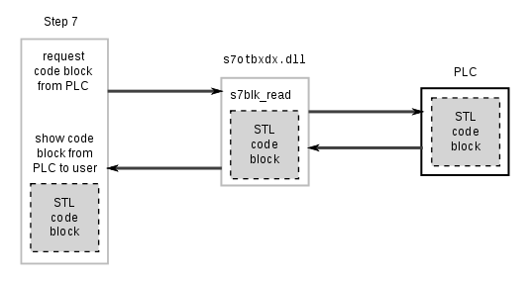
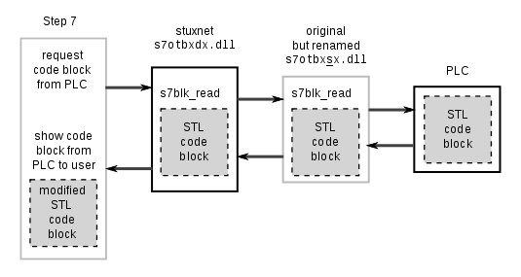
Normal Communication between Step7 and a Siemens PLC
Stuxnet hijacks Communication between
Step7 and a Siemens PLC
Image Source: https://en.wikipedia.org/wiki/Stuxnet

Slide 20
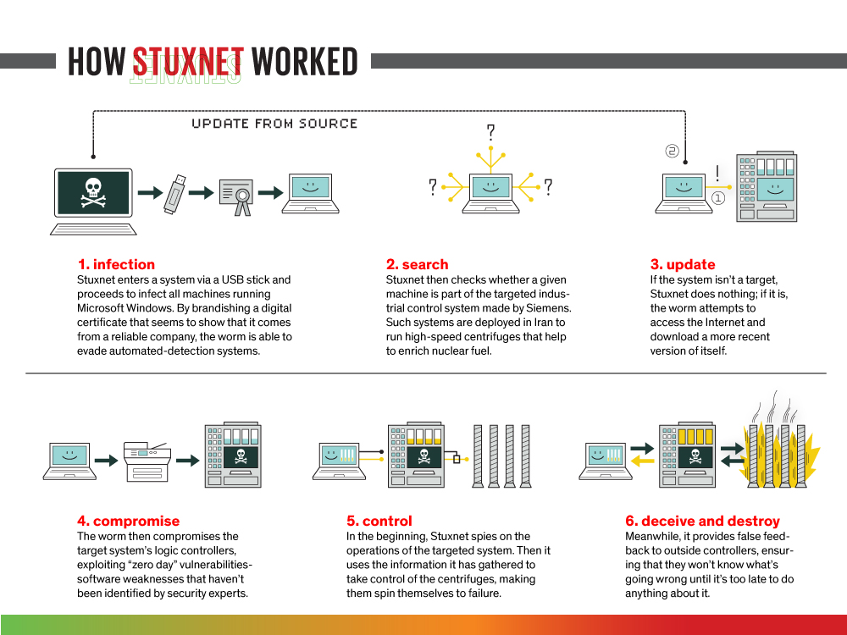
Stuxnet: A Worm: How did it work?
Image borrowed from:

Slide 21
Types of Malware: Trojans
Spread by appearing safe and hiding their true intent
They do not replicate themselves
May get installed with elevated privileges
Perform damaging actions within the system
Modify or delete files
Spy on user activities for Id-theft, key-logging, viewing webcam
Use machine as part of a botnet
Use computer for mining cryptocurrencies
Use computer as proxy for illegal activities
Use computer for Money theft /Ransom (Cryptolocker)
A List of some identified Trojans

Slide 22
A Typical Banking Trojan
Victim infected by malicious email or a visit to a website
Trojan waits for user to login to a banking website
Uses keylogging or pop-up windows to steal credentials
Redirects victim to a fake website that mimics the bank’s site
Victim logs into fake site, the trojan logs into the real site
Any two factor code sent to the user is captured by the trojan
With all credentials in hand, trojan operates the victim’s bank account

Slide 23
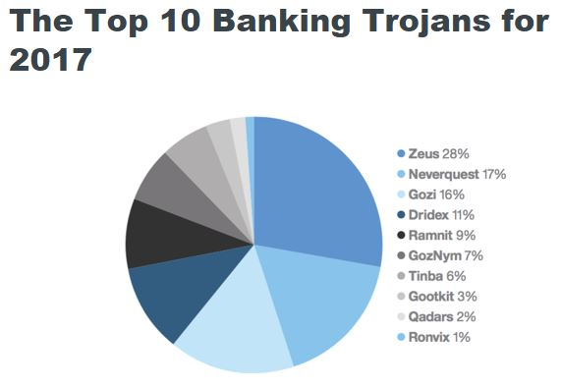
Source: https://www-03.ibm.com/press/us/en/pressrelease/51982.wss

Slide 24
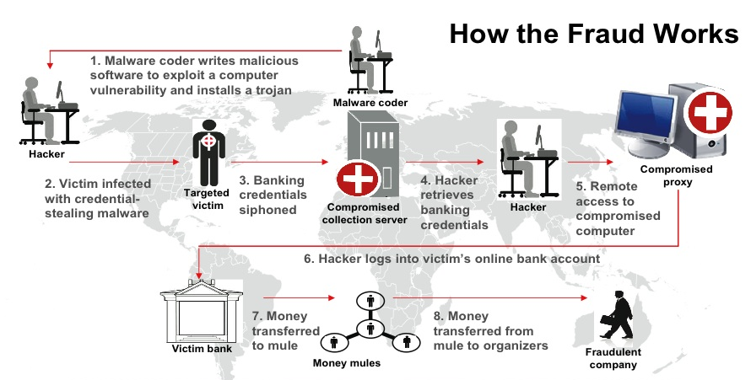
How “Zeus” Trojan Works
Image source: http://www.zdnet.com/article/zeus-returns-fbi-warns-of-gameover-id-theft-malware/

Slide 25
Dragonfly: A Trojan Attack for Industrial Espionage⁴
Dragonfly is a Remote Access Trojan (RAT) Horse
Only did espionage, caused no physical damage to plants
Infected systems during 2010-2014, discovered in 2013
Targeted ICS components
Manufacturing, Energy, and Pharma
across US and Europe
Initial targets: aviation and defense industries (US and Canada)
Spear-Phishing attacks against high level individuals
Used Watering-Hole attack strategy against these individuals
Infected ICS vendors’ websites
Inserted Malware in software updates downloaded by PLCs

Slide 26
Dragonfly: A Trojan Attack for Industrial Espionage⁴ (2)
Three-Phase Campaign:
Phase-1: Infect users’ computers – gain access to all their files
RAT Malware: Provides remote access to infected computers
Phase-2: Industry experts redirected from legit websites to Dragonfly servers
These sites contained infected versions of software that experts needed
Phase-3: Hacked into ICS component Vendors’ websites to infect the downloaded software updates

Slide 27
Dragonfly: A Trojan Attack for Industrial Espionage⁴ (3)
Information Stolen:
Contact lists from Outlook email servers
Network details for communication with Process Control Networks
OPC (Ole for Process Control) information
Karagany payload was delivered to some infected computers
This could steal and send back password files and screen-shots
A network scanner that looked for SCADA software
Only espionage was detected; but actual physical damage is very much possible

Slide 28
Types of Malware: Spyware/Adware
Monitors User’s activity for marketing purposes
Keeps track of web searches done by a user
Displays advertisements relevant to a user’s interests
Can collect any type of information from the system:
Internet surfing histories, logins, bank account information
Not a virus: Infected systems do not seek to infect others
Some of them disable firewalls, letting more malware in
Lot of anti-spyware products available
Germeny and Switzerland have laws regulating the types of spyware that is permitted
Vizio smart TV manufacturer has a spyware recording what all you watch on their TVs (Fined by FTC in Feb 2017)
Image borrowed from:

Slide 29
Phishing and Water-Hole Attacks
Phishing
Most wide-spread cybercrime these days
Works because attackers play mind tricks with victims
2014 FIFA:
fake fifa website asked people to sign petition supporting Uruguay Luis Albert Suarez
Asked name, country, mobile#, and email id
Attackers send emails from victims’s friends
Constantly evolving: Mobile device phishing (rising recently)

Slide 30
Phishing and Water-Hole Attacks
Spear Phishing
Targets the user via his/her trusted links (frequently visited friends/websites)
Waterhole attacks
Attacker investigates the victim to find his/her behavior
Sends links to fake/infected websites (music, golf, movies?)
91% attacks begin with Phishing/Spear Phishing
RSA’a parent company EMC has been a victim (2011)
Email to 4 employees had attachment “2011 Recruitment Plan.xls”
Attackers gained access to company’s anti-attack products

Slide 31
Denial of Service Cyber Attacks
Make a server dysfunctional by flooding it with messages
Its like crowding a gate by unnecessary traffic so that real traffic cannot get through
In 2015 botnets were used to attack Banks to extract ransom
Firewalls routers and switches can be used to defend against DoS attacks
Image borrowed from:

Slide 32
Denial of Service Cyber Attacks
Brown’s Ferry3 PLC Failure
In August 2006 TVA was forced to manually shut down one of their plant’s two reactors
Unresponsive PLCs caused two water pumps to fail
Testing on the failed PLCs discovered they would crash when they encountered excessive network traffic
A condition for which PLCs are rarely tested
Image borrowed from:

